Slide 1
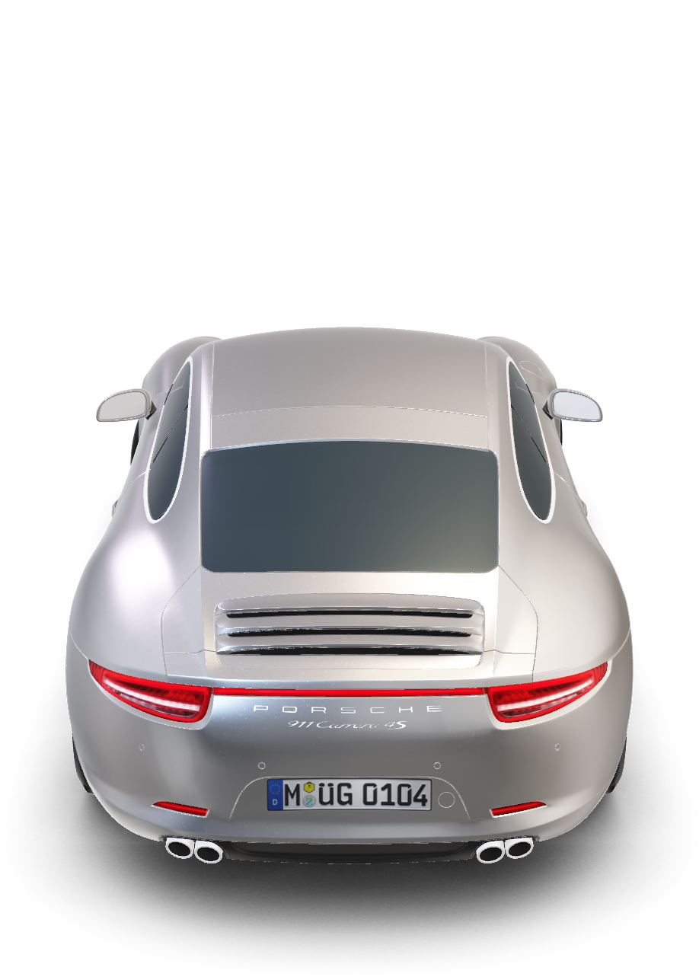
Porsche Carrera S

Slide 2
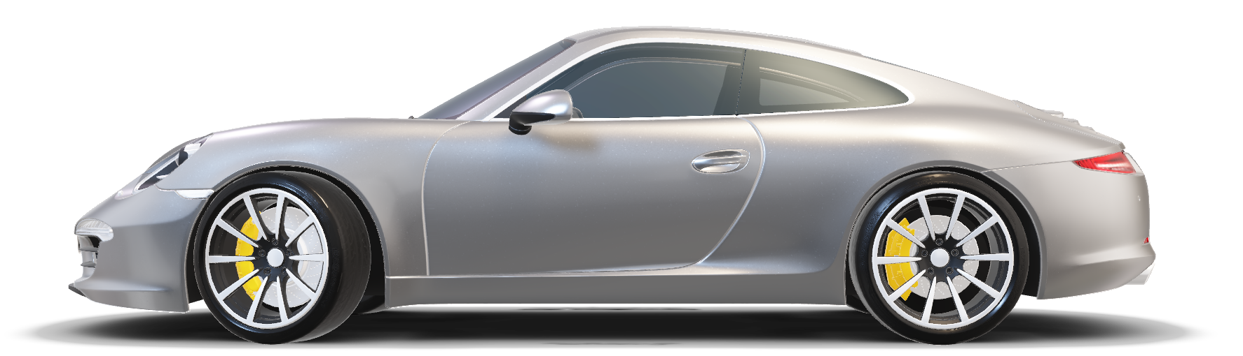
Porsche Carrera S

Slide 3
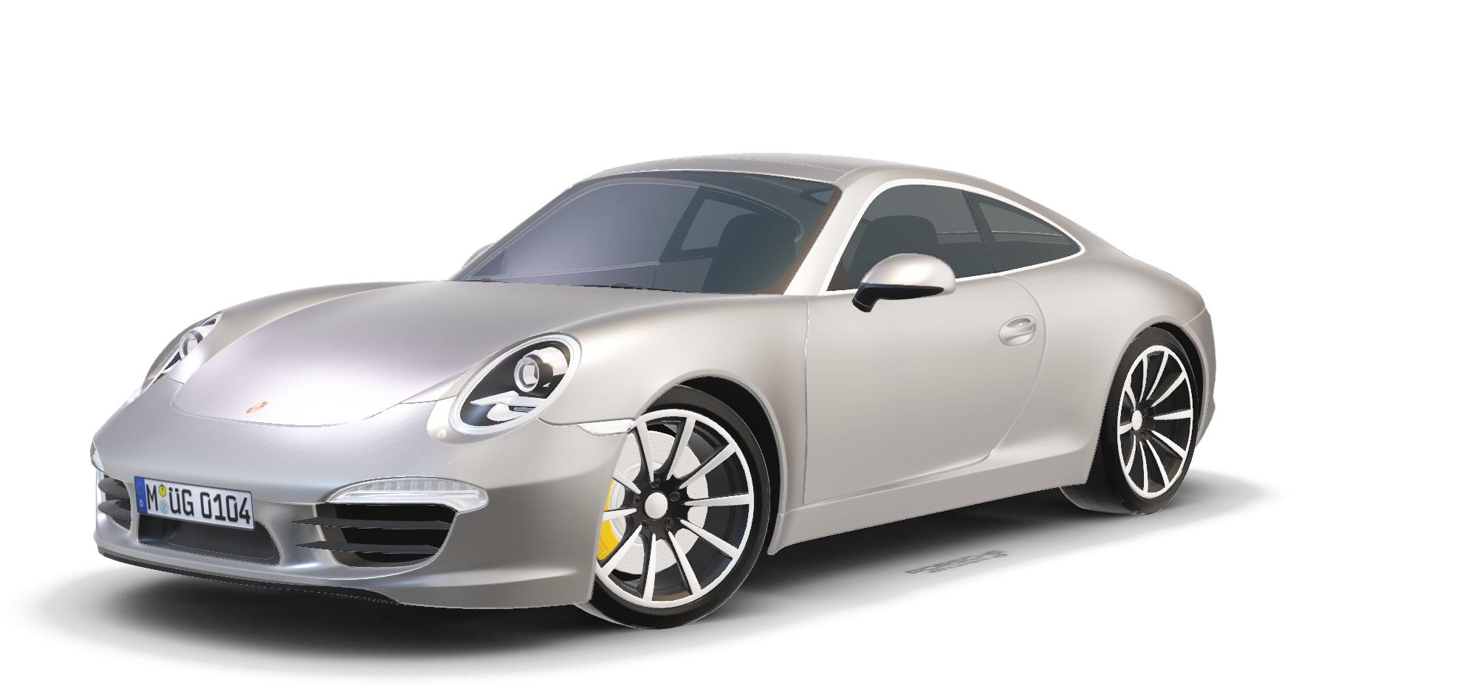
Porsche Carrera S
The Porsche Carrera S is a renowned sports car with a powerful engine, typically a 3.0-liter twin-turbocharged flat-six. It offers exceptional handling, rear-wheel drive, and a finely tuned suspension. With luxurious features and advanced technology, the Carrera S delivers an exhilarating driving experience and timeless style.
Details:
379hp
Max Power
4.0s
0-60 mph
180
Top Speed

Slide 4
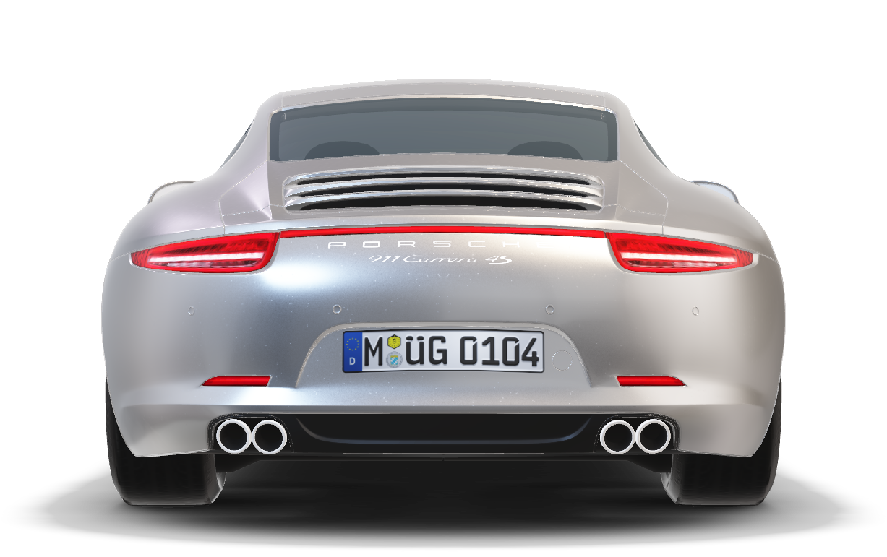
Porsche Carrera S
Timeless Design ,
Contemporary
Interpretation
The Porsche Carrera S is a renowned sports car with a powerful engine, typically a 3.0-liter twin-turbocharged flat-six. It offers exceptional handling, rear-wheel drive, and a finely tuned suspension. With luxurious features and advanced technology, the Carrera S delivers an exhilarating driving experience and timeless style.
The Harmony of Tradition
And Modernity- The iconic flyline and the continuous light strip
The Porsche Carrera S features a timeless design that seamlessly blends classic elegance with contemporary elements. Its iconic silhouette and sleek lines pay tribute to Porsche's heritage while incorporating modern aerodynamic enhancements, resulting in a visually striking and captivating sports car.
Details:
379hp
Max Power
4.0s
0-60 mph
180
Top Speed

Slide 5
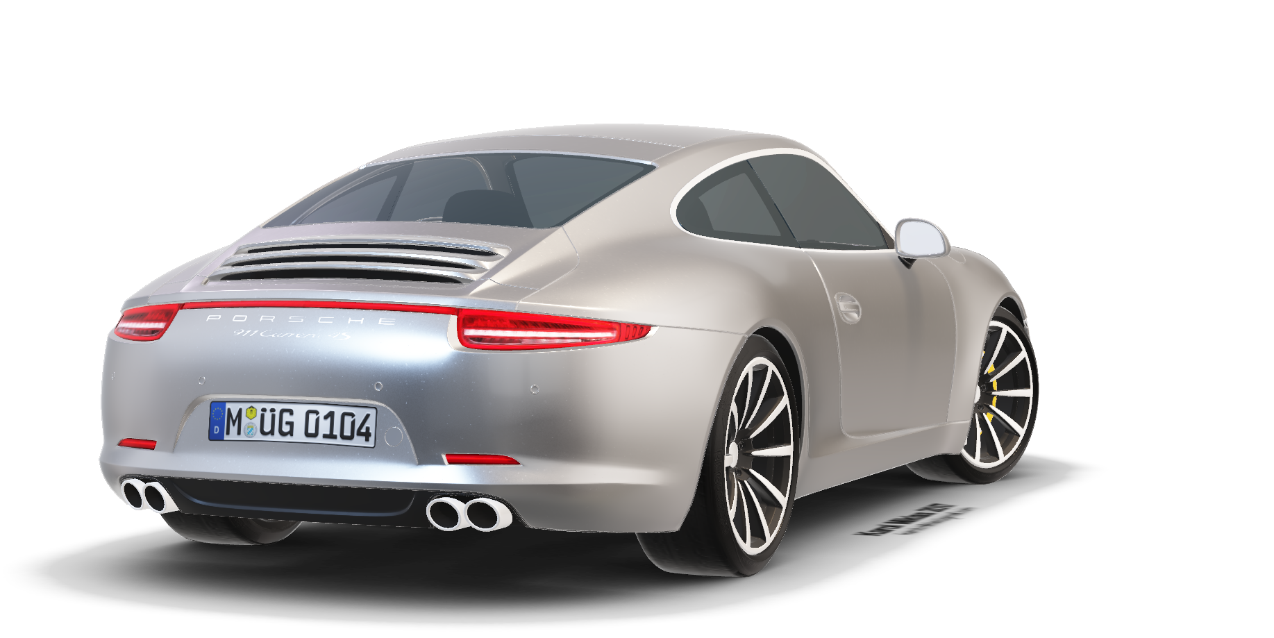
Timeless Design ,
Contemporary
Interpretation
The Porsche Carrera S features a timeless design that seamlessly blends classic elegance with contemporary elements. Its iconic silhouette and sleek lines pay tribute to Porsche's heritage while incorporating modern aerodynamic enhancements, resulting in a visually striking and captivating sports car.
Porsche Carrera S
The Porsche Carrera S is a renowned sports car with a powerful engine, typically a 3.0-liter twin-turbocharged flat-six. It offers exceptional handling, rear-wheel drive, and a finely tuned suspension. With luxurious features and advanced technology, the Carrera S delivers an exhilarating driving experience and timeless style.
The Harmony of Tradition
And Modernity- The iconic flyline and the continuous light strip
Details:
379hp
Max Power
4.0s
0-60 mph
180
Top Speed

Slide 6

Timeless Design ,
Contemporary
Interpretation
The Porsche Carrera S features a timeless design that seamlessly blends classic elegance with contemporary elements. Its iconic silhouette and sleek lines pay tribute to Porsche's heritage while incorporating modern aerodynamic enhancements, resulting in a visually striking and captivating sports car.
Porsche Carrera S
Details:
379hp
Max Power
4.0s
0-60 mph
The Porsche Carrera S is a renowned sports car with a powerful engine, typically a 3.0-liter twin-turbocharged flat-six. It offers exceptional handling, rear-wheel drive, and a finely tuned suspension. With luxurious features and advanced technology, the Carrera S delivers an exhilarating driving experience and timeless style.
180
Top Speed
The Harmony of Tradition
And Modernity- The iconic flyline and the continuous light strip

Slide 7
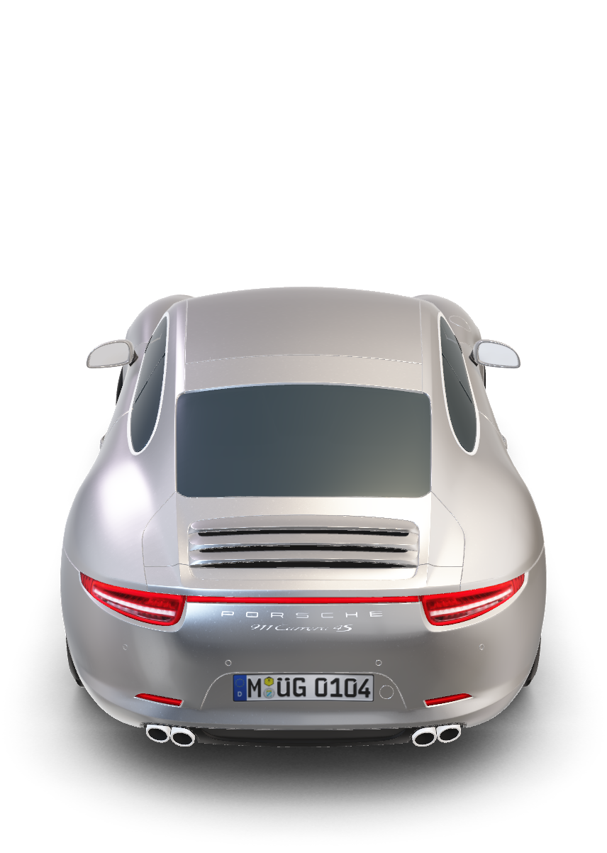
Timeless Design ,
Contemporary
Interpretation
The Porsche Carrera S features a timeless design that seamlessly blends classic elegance with contemporary elements. Its iconic silhouette and sleek lines pay tribute to Porsche's heritage while incorporating modern aerodynamic enhancements, resulting in a visually striking and captivating sports car.
Porsche Carrera S
Details:
379hp
Max Power
The Porsche Carrera S is a renowned sports car with a powerful engine, typically a 3.0-liter twin-turbocharged flat-six. It offers exceptional handling, rear-wheel drive, and a finely tuned suspension. With luxurious features and advanced technology, the Carrera S delivers an exhilarating driving experience and timeless style.
4.0s
0-60 mph
180
Top Speed
The Harmony of Tradition
And Modernity- The iconic flyline and the continuous light strip

